Slide 1
Building
3rd floor response
ANN
2nd floor response
1st floor response
Excitation Signal

Slide 2
Building
2nd floor response
1st floor response
Excitation Signal

Slide 3
X_{t-2}
X_{t-1}
X_{t}
Y_{t}
Y_{t-3}
Y_{t-2}
Y_{t-1}
W₁=2
X_{t} × w₁
w₂=4
X_{t-1}×w₂
w₃=0
Y_{t-2}×w₃
+b=Y_{t}
w₄=1
Y_{t-1}×w₄
W₅=0
Y_{t-2}×w₅
W₆₌₀
Y_{t-3}×w₆
Y_{t}
b=4.1017e-15
Y_{t}

Slide 4
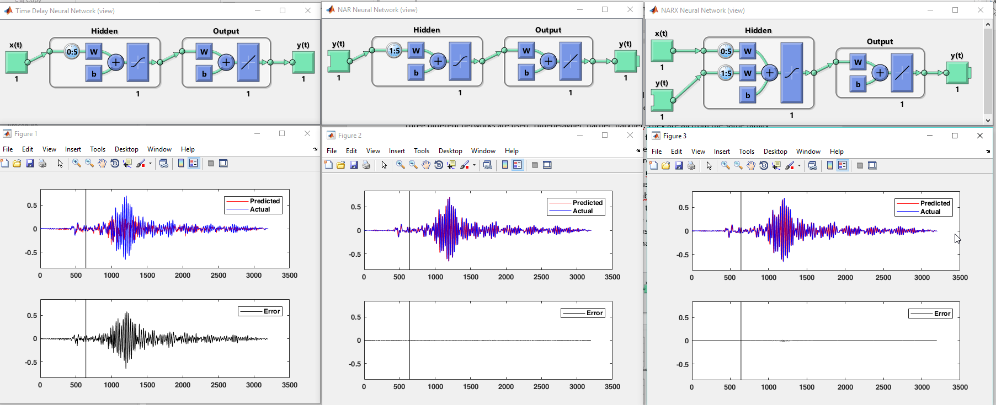

Slide 5
Model6.m
Input data for ANN
generates
NN_Openseesdata
Predicted Values
Input data for OpenSees
Model1-2.tcl

Slide 6
Model6.m

